Slide 1
Light Sensors and Braitenberg Behaviors
Team 6:
Neil Forrester
Daniel Gonzalez
Raghavendra Srinivasan
James Wiken
Notes:
1

Slide 2
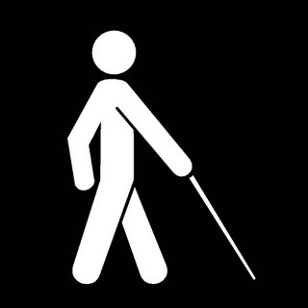
Simple reactive behaviors
Robots aren't useful if they can't adapt to what's happening in the real world.
There are ways around blindness, but there are limits to what's possible.
Notes:
2

Slide 3
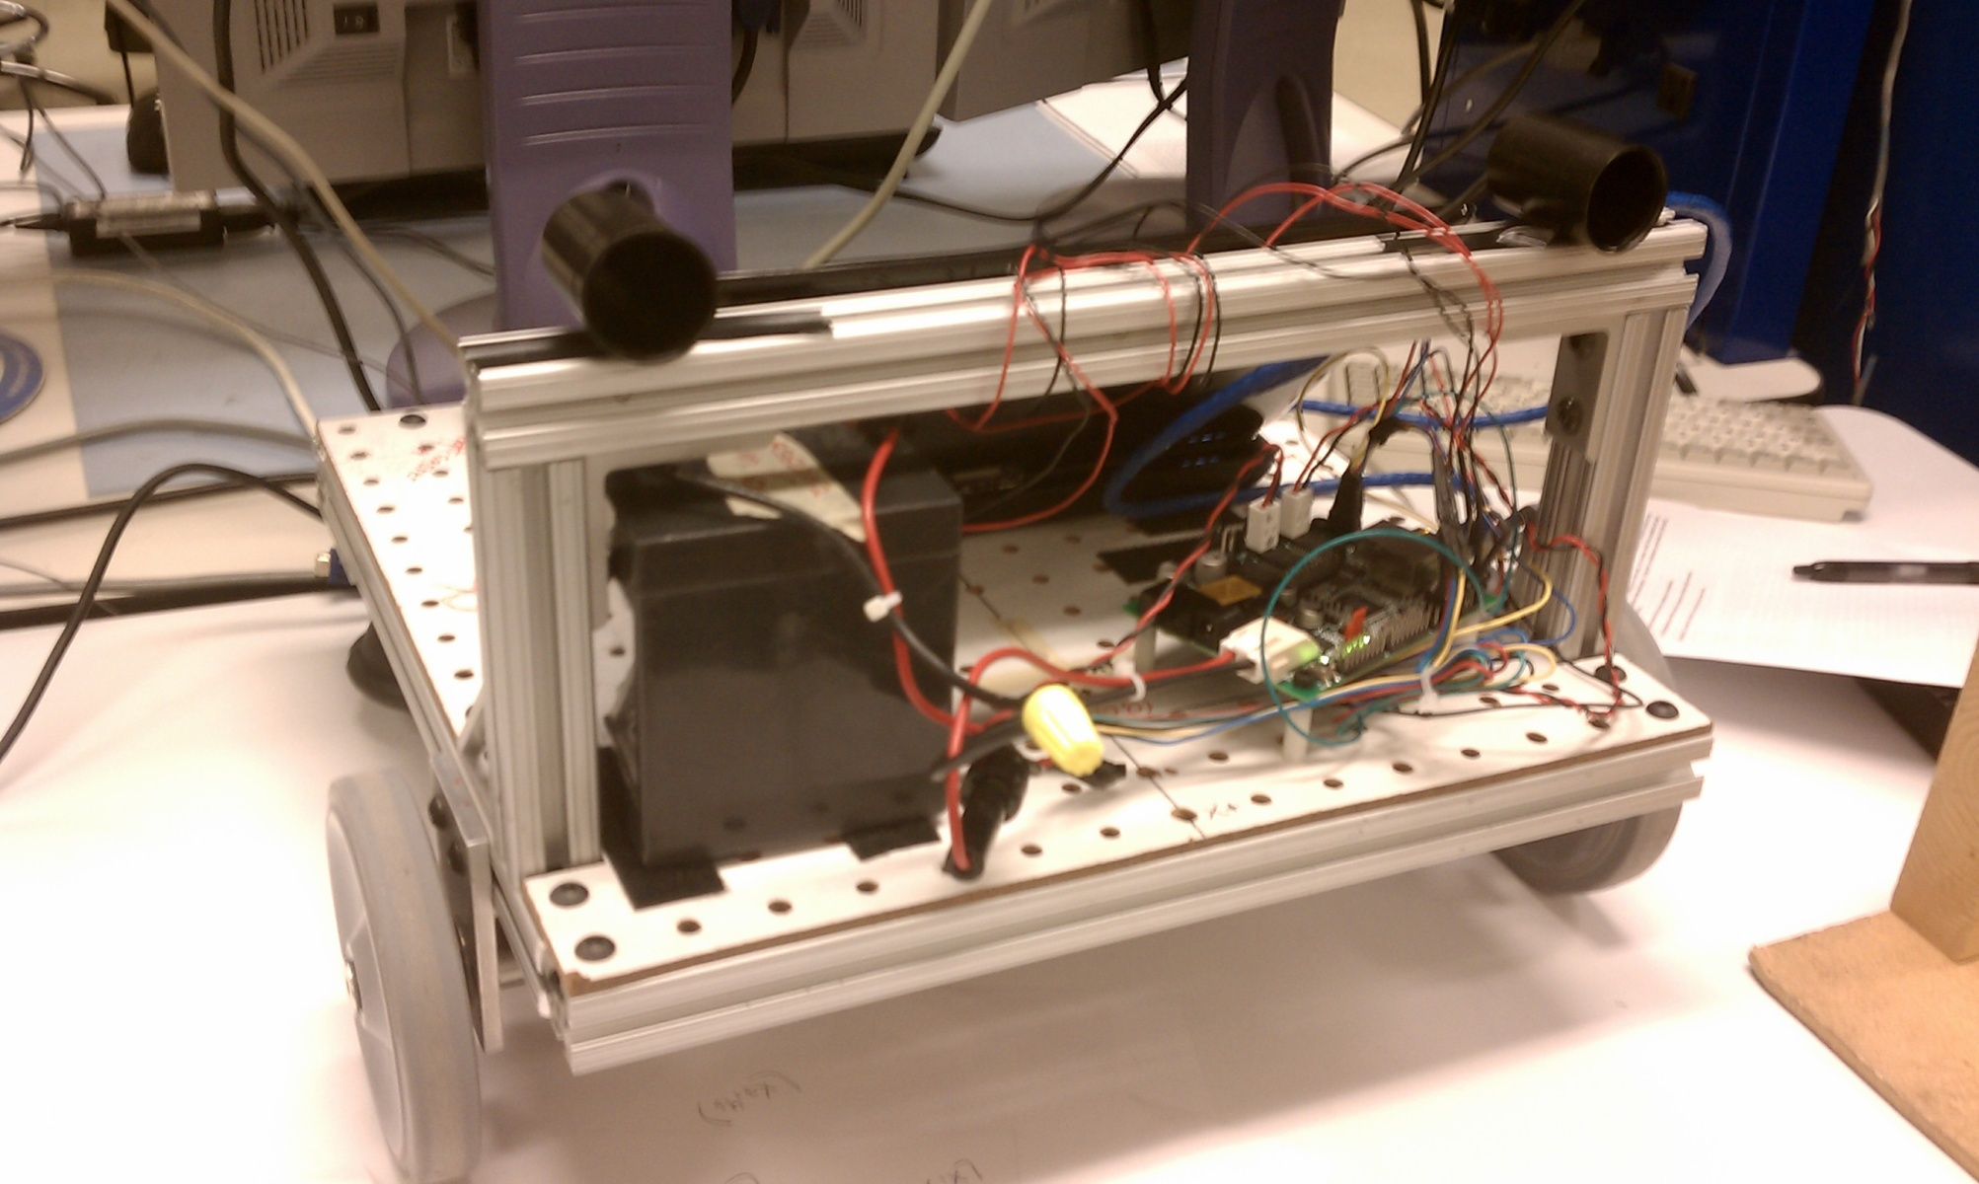
Light Sensors
Notes:
3

Slide 4
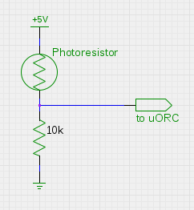
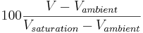
Photoresistor
Resistance:
Dark – 150k - 200k
Ambient – 10k - 30k
Saturation - 200
Calibration:
Notes:
4

Slide 5
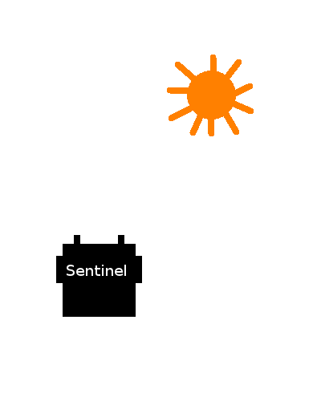
Searching for a light source
Low value
High value
Notes:
5

Slide 6
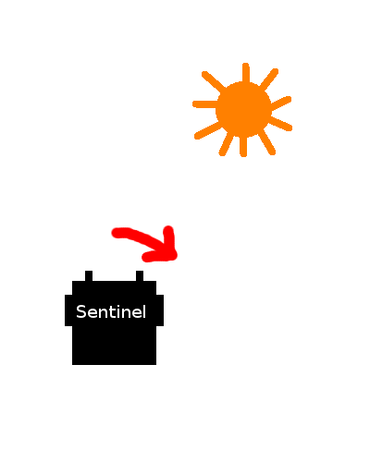
Searching for a light source
Low value
High value
Notes:
6

Slide 7
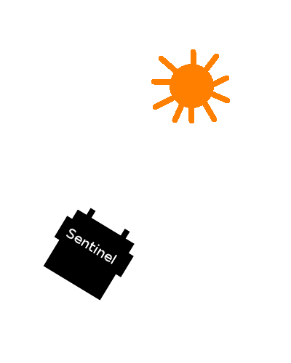
Searching for a light source
Roughly equal values
Notes:
7

Slide 8
Moving to a light source
Values below threshold
Notes:
8

Slide 9
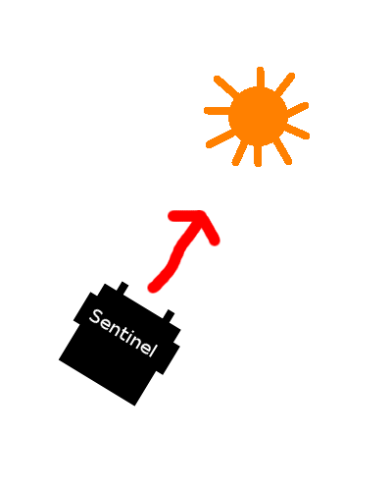
Moving to a light source
Values below threshold
Notes:
9

Slide 10
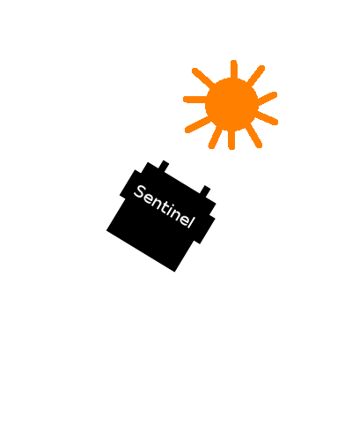
Moving to a light source
At least one value
above threshold
Notes:
10

Slide 11
Braitenberg Behaviors
Wheel velocities are simple functions of light sensor values.
Easy emotional responses!
Puppy!
Shy...
Aggressive!
Excited, but afraid.
Notes:
11

Slide 12


Slide 13
What we learned
Emotional responses for Personal Robots
Dan learned about photoresistors
Cadmium sulfide has variable resistance when exposed to light! Who knew?
Raga is good at video editing
Notes:
13

